Slide 1

The Economics of Old School Runescape's Bonds
Lawrence Yu

Slide 2
Why I chose this project
Familiarity with Old School Runescape (OSRS)
Real world impacts on OSRS markets in the past imply a potential correlation
Curious to see if a meaningful correlation can be found in an unlikely place

Slide 3
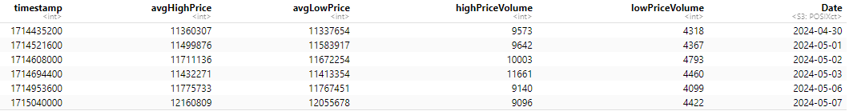
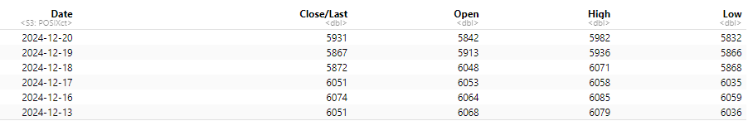
Data Sources
OSRS Prices API: https://oldschool.runescape.wiki/w/RuneScape:Real-time_Prices
S&P 500 Historical Data: https://www.nasdaq.com/market-activity/index/spx/historical?page=1&rows_per_page=10&timeline=y5

Slide 4
Concerns and considerations with data
Available time frames available for each data source did not match.
Rate limiting risks and other limitations in OSRS API reduced the amount of usable data.
OSRS market is always active regardless of time unless the game itself is down for maintenance while the stock market pauses for weekends and holidays.
Date format needed to be streamlined to be matched across both data sets.
There is a risk that a correlation is found when it might not exist.

Slide 5
Who would benefit from this analysis
If a correlation is found, real world stock traders may have an extra and unique tool to help study stock trends.
OSRS players can benefit when trading in OSRS's Grand Exchange market.

Slide 6
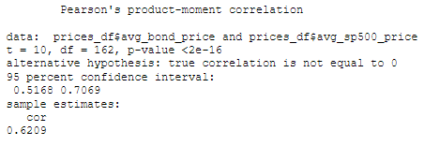
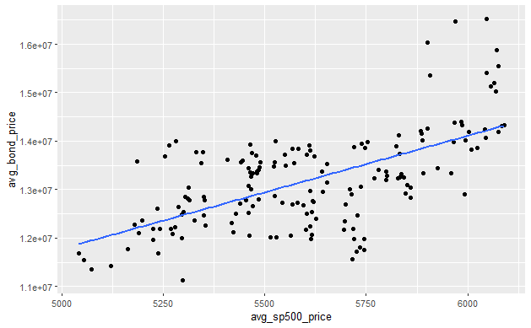
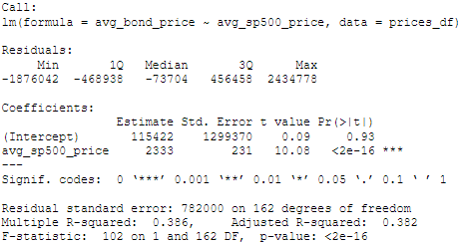
Findings: Linear Regression

Slide 7
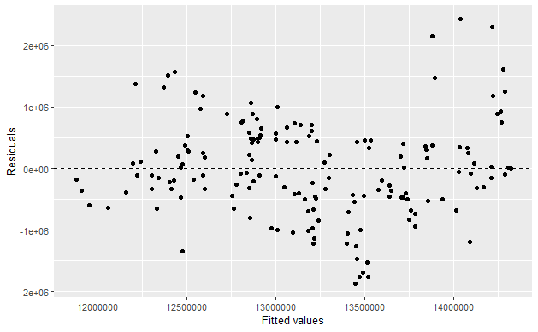
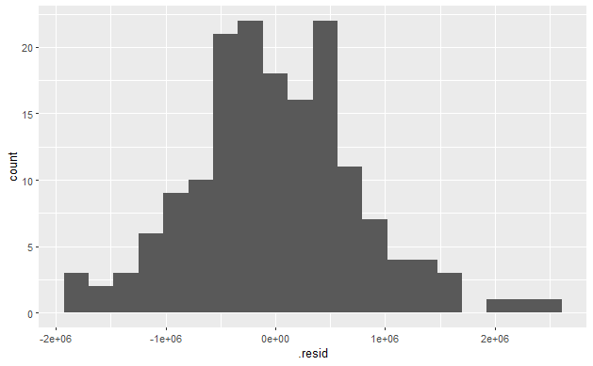
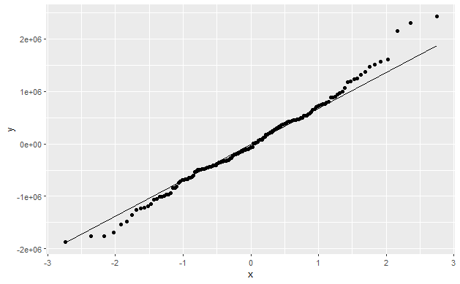
Findings: Linear Regression Residuals

Slide 8
Findings: ARIMA Models
Wrangled OSRS bonds data: ARIMA(0, 1, 0)
Wrangled S&P 500 data: ARIMA(0, 1, 1)
Full year OSRS bonds data: ARIMA(1, 1, 3)
5 years S&P 500 data: ARIMA(0, 1, 1) with drift
What does this all mean?
There is evidence of patterns that our data is missing.
OSRS bonds data model changes when removing weekend data. That information is significant.
S&P 500 data model is missing its upward trend when analyzing a very specific subset of the data.

Slide 9
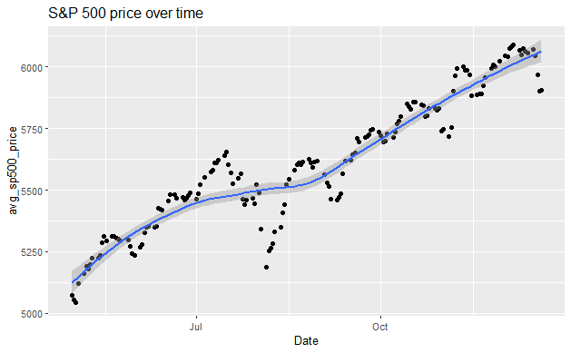
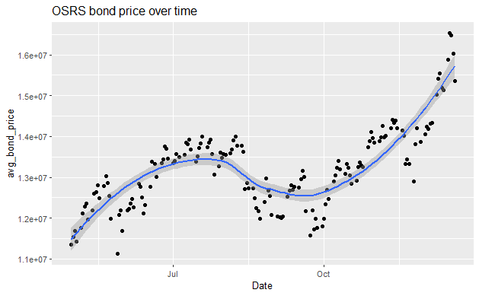
Recommendations
"It's not what you look at that matters, it's what you see." - Henry David Thoreau

Slide 10
Key challenges overcome
Date format was inconsistent between data. Solution:
Bond prices could only reach up to 365 data points maximum from the time the API was called. Solution: Manually saved a copy of the retrieved data to test with.
Could like create linear model because of uneven amount of data for selected time frame due to stock market being closed on weekends and holidays. Solution:
Analysis felt flawed despite the linear regression model appearing to fit. Solution: Fitted ARIMA models for the time series since they do not require that the two prices data sets be the exact same length (and thus be from the same times).

Slide 11
Conclusion
Unable to confirm a correlation between OSRS bonds and S&P 500 prices.
Analysis of linear regression model implies a strong linear correlation.
However, there are concerns regarding the narrow range of data that was used to build model.
Eye test of scatter plot suggests that there are trends such as seasonality that are not being represented.
Further work:
Redo analysis after collecting more years of data. Try other methods such as the Granger causality test instead of fitting a linear regression model.

